Slide 1
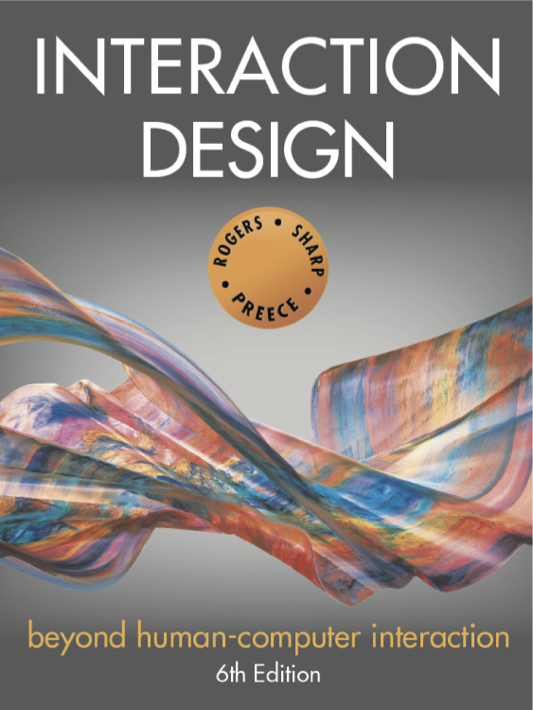
Chapter 2
THE PROCESS OF INTERACTION DESIGN

Slide 2
Overview
What is involved in Interaction Design?
  Who to involve in the design process
  Importance of involving users
  Degrees of user involvement
  What is a people-centered approach?
  Four basic activities of interaction design
  A simple lifecycle model for interaction design
Some practical issues
  How to find out what people need
  How to decide what to design
  How to generate alternative designs
  How to choose among alternative designs
  How to integrate interaction design activities within other lifecycle models

Slide 3
What is involved in Interaction Design?
It is a process:
  Focused on discovering requirements, designing to fulfil requirements, producing prototypes and evaluating them
  Focused on users and their goals
  Involves trade-offs to balance conflicting requirements
Generating alternatives and choosing between them is key
Four approaches: user-centered design, activity-centered design, systems design, and genius design

Slide 4
The double diamond of design
Source: Adapted from www.designcouncil.org.uk/news-opinion/what-framework-innovation-design-councils-evolved-double-diamond

Slide 5
Who to involve in interaction design
Identify stakeholders for the product
  Individuals or groups who influence or are influenced by the success or failure of the project
  Users are not the only stakeholders
  Direct and indirect users, developers, executives, legislators
Involving stakeholders is not always easy
  May not need to involve all groups
  Knowing the stakeholder groups is only the first step!

Slide 6
Importance of involving users
Expectation management
  Realistic expectations
  No surprises, no disappointments
  Timely training
  Communication, but no hype
Ownership
  Make the users active stakeholders
  More likely to forgive or accept problems
  Can make a big difference in acceptance and success of product

Slide 7
Degrees of user involvement
Member of the design team
Small group or individual activities
Online contributions from thousands of users
  Online Feedback Exchange (OFE) systems
  Crowdsourcing design ideas
  Citizen engagement
Participatory design
User involvement after product release
  A/B testing
  Customer reviews

Slide 8
What is a people-centered approach?
Three principles for “useful & easy-to-use” products
  Early focus on users and tasks
  Empirical measurement
  Iterative design
Expanded to include
  People’s tasks and goals drive development
  People’s behaviour and context is studied
  People’s characteristics are designed for
  Stakeholders are consulted throughout
  Design decisions are taken in this context
  Specific usability and user experience goals
  Iteration through all interaction design activities

Slide 9
Four basic activities of Interaction Design
  Discovering requirements
  Designing alternatives
  Prototyping alternative designs
  Evaluating product and its user experience throughout

Slide 10
A simple interaction design lifecycle model
Exemplifies a people-centered design approach

Slide 11
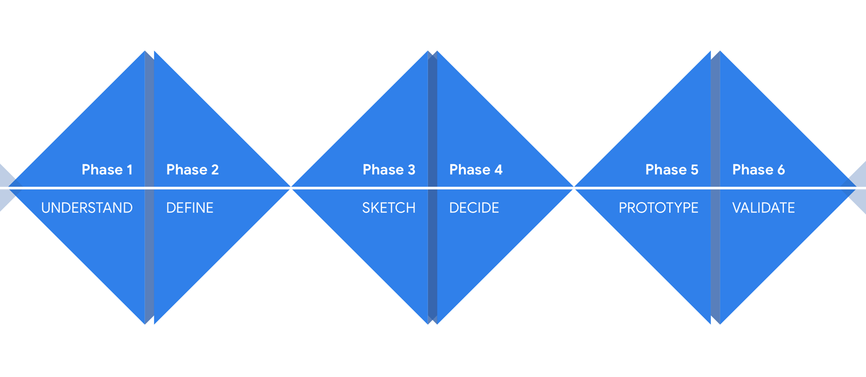
Another lifecycle model:
Design Sprints
Source: designsprintkit.withgoogle.com/methodology/overview

Slide 12
Another lifecycle model:
Research in the Wild (Rogers and Marshall, 2017)
A framework for research in the wild studies
Source: Rogers and Marshall, 2017, p6. (used courtesy of Morgan and Claypool)

Slide 13
Some practical issues
How to find out what people need
How to decide what to design
How to generate alternative designs
How to choose among alternatives
How to integrate interaction design activities with other lifecycle models

Slide 14
How to find out what people need
Users rarely know what is possible
Instead:
  Explore the problem space
  Investigate potential users and their activities
  Try out ideas with potential users
Focus on peoples’ goals, usability, and user experience goals, rather than expect stakeholders to articulate requirements

Slide 15
How to decide what to design
Explore
  What is the current user experience?
  Why is a change needed?
  How will this change improve the situation?
Articulating the problem space
  Team effort
  Explore different perspectives
  Avoid incorrect assumptions and unsupported claims

Slide 16
How to generate alternative designs
Humans tend to stick with something that works
Considering alternatives helps identify better designs
Where do alternative designs come from?
  ‘Flair and creativity’: research and synthesis
  Cross-fertilization of ideas from different perspectives
  Users can generate different designs
  Prompts to provoke thinking, e.g. SCAMPER
  Seek inspiration: other products and domain
  Different perspectives
Balancing constraints and trade-offs

Slide 17
How to choose among alternatives
Interaction design focuses on externally-visible and measurable behavior
Technical feasibility
Evaluation with users or peers
  Prototypes not static documentation because behavior is key
A/B Testing
  Online method to inform choice between alternatives
  Nontrivial to set appropriate metrics and choose user group sets
Quality thresholds
  Different stakeholder groups have different quality thresholds
  Usability and user experience goals lead to relevant criteria

Slide 18
How to integrate interaction design activities within other models
Integrating interaction design activities in lifecycle models from other disciplines requires careful planning
Software development lifecycle models are prominent
Integrating with agile software development:
  It incorporates tight iterations
  It champions early and regular feedback
  It handles emergent requirements
  It aims to strike a balance between flexibility and structure

Slide 19
Some key points
Four basic activities in interaction design process
  Discovering requirements
  Designing alternatives
  Prototyping
  Evaluating
People-centered design rests on three principles
  Early focus on users and tasks
  Empirical measurement
  Iterative design
Understand problem space before starting design
Involve stakeholder groups throughout development
Generate alternative designs and evaluate them

